Slide 1
Technical and Business Writing
Miss. Aqsa Ashraf
ENG-201
Week 4, Lecture 1

Slide 2
Organizing information and generation solution

Slide 3





www.tuf.edu.pk
unioffaisalabad
Definition of Organizing Information:
Organizing information refers to the process of arranging data, facts, or knowledge in a structured manner that makes it easier to access, understand, and use. This can involve categorizing, classifying, and prioritizing information based on specific criteria, which helps in creating a coherent framework for retrieval and analysis.

Slide 4
www.tuf.edu.pk
unioffaisalabad
What is Generating solutions?
Generating solutions is about discovering ways of bridging the current state to the future, improved state. There are many different ways to problem solve. Techniques are most successful when the process is inclusive, inquisitive and creative.

Slide 5
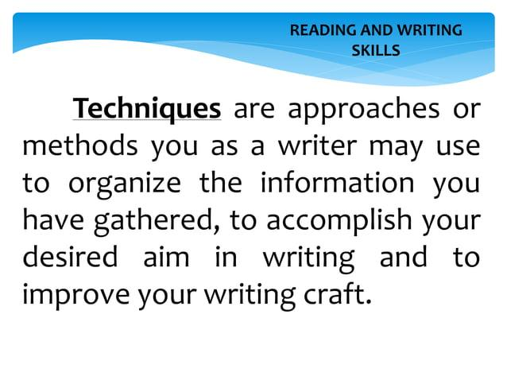
www.tuf.edu.pk
unioffaisalabad
What is Generating solutions?
Generating solutions is about discovering ways of bridging the current state to the future, improved state. There are many different ways to problem solve. Techniques are most successful when the process is inclusive, inquisitive and creative.

Slide 6
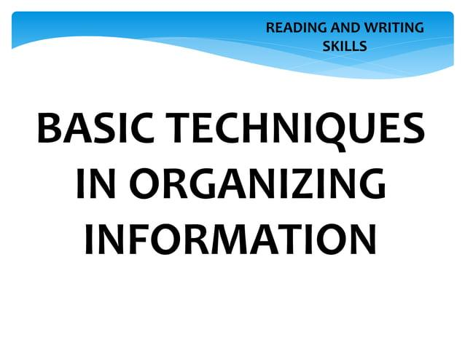
www.tuf.edu.pk
unioffaisalabad

Slide 7
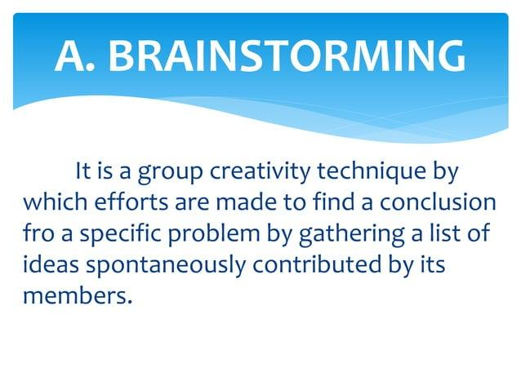
www.tuf.edu.pk
unioffaisalabad

Slide 8
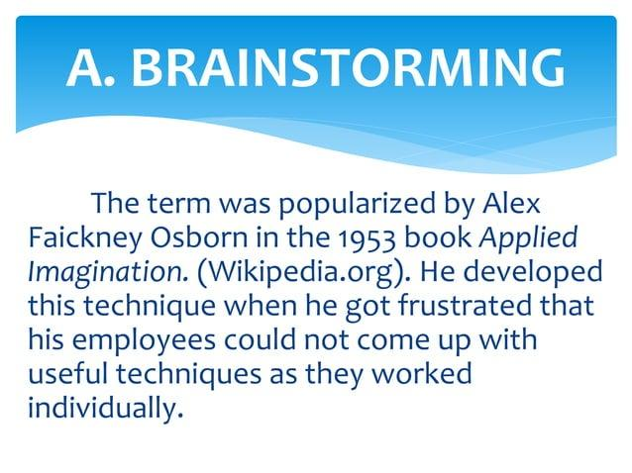
www.tuf.edu.pk
unioffaisalabad

Slide 9
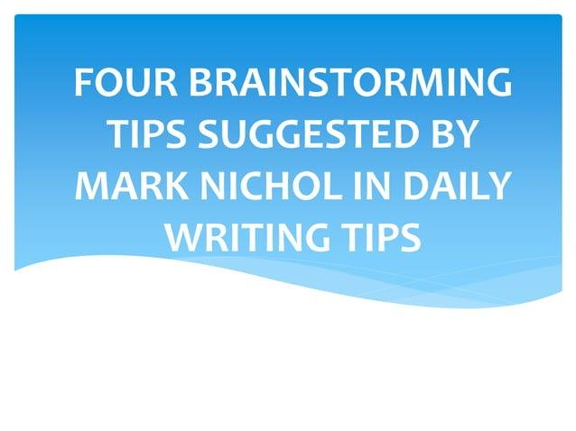
www.tuf.edu.pk
unioffaisalabad

Slide 10
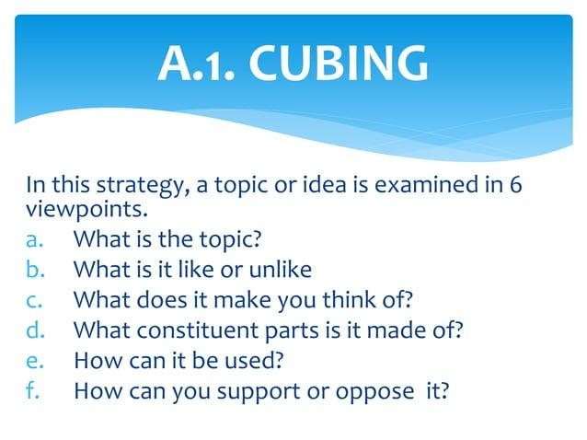
www.tuf.edu.pk
unioffaisalabad

Slide 11
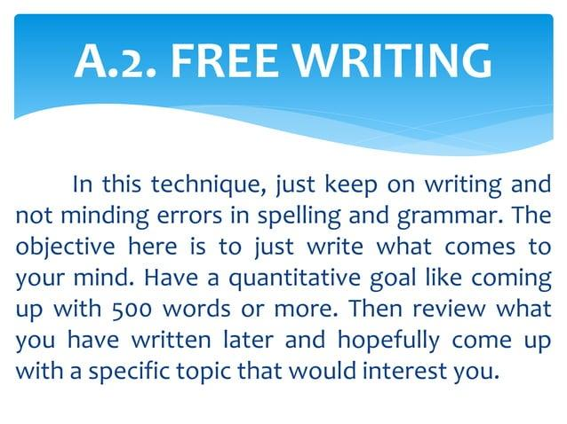
www.tuf.edu.pk
unioffaisalabad

Slide 12
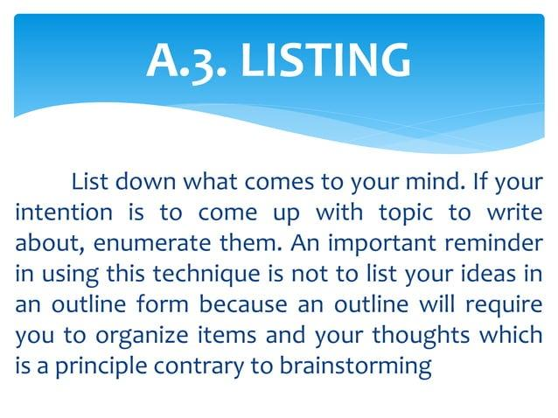
www.tuf.edu.pk
unioffaisalabad

Slide 13
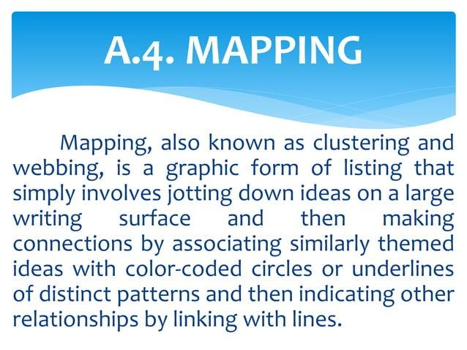
www.tuf.edu.pk
unioffaisalabad

Slide 14
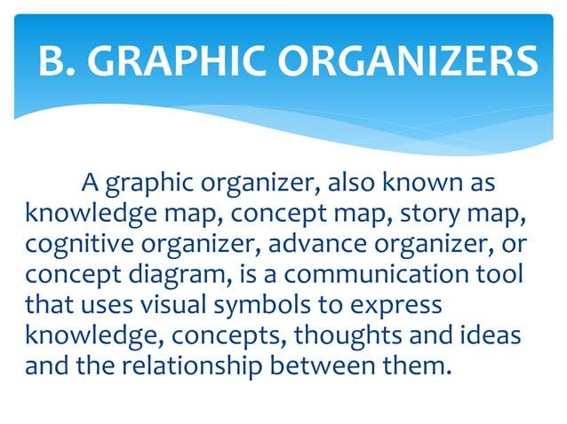
www.tuf.edu.pk
unioffaisalabad

Slide 15
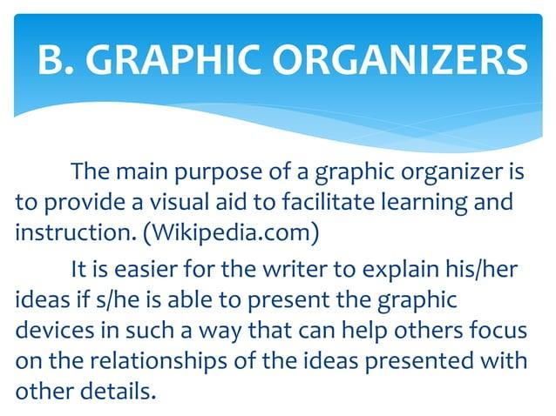
www.tuf.edu.pk
unioffaisalabad

